Slide 1

CS574 Object-Oriented Analysis & Design
CS574 Lecture 4
Over the course of the semester we will be doing requirements, analysis, and design of an eBay-related application for which I am the customer/client.

Slide 2
Requirements Engineering
CS574 Object-Oriented Analysis & Design
In a real world software development project, the client comes to the development team with a perceived need for software to solve a problem or automate a workflow. The client typically has no idea how software development works, and the development team typically has no idea how the client’s organization works. The team knows, for example, what a bank or an insurance company is/does, but has no clue regarding the details of how it operates or what software to help it should do.

Slide 3
Requirements Engineering (cont.)
CS574 Object-Oriented Analysis & Design
The proper way to proceed is for the team to elicit from the client an initial idea of what the software is to do. The team then constructs a first version of a GUI Prototype, to make the design as unambiguous as possible, and presents it to the client.

Slide 4
Requirements Engineering (cont.)
CS574 Object-Oriented Analysis & Design
What typically happens is that the client responds with “these two parts of your initial design look really good, but this part here and that part there tell me that you don’t understand how two critical parts of our organization actually work, so let me tell you.” The team then does a second iteration of the GUI prototype. After a number of additional iterations, the client is satisfied that if it is implemented the software will satisfy his/her (organization’s) needs.

Slide 5
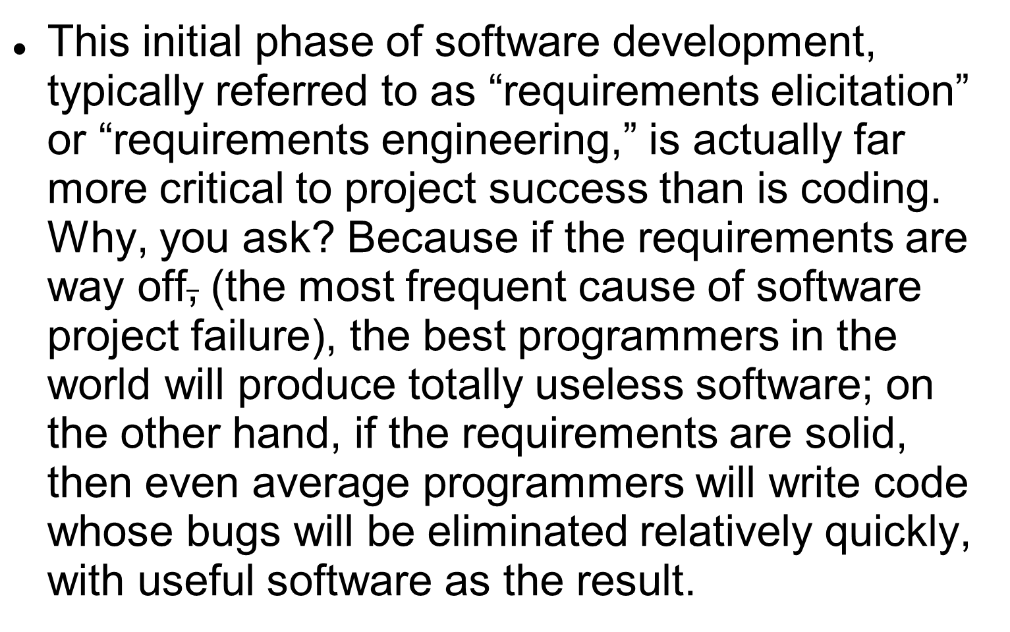
Requirements Engineering (cont.)
CS574 Object-Oriented Analysis & Design

Slide 6
Requirements Engineering (cont.)
CS574 Object-Oriented Analysis & Design
In fact, quantitative studies show that the rework necessary to “fix” software implemented from bad requirements costs between ten and one hundred times as much – in dollars and person hours – as software implemented from solid requirements with less-than-perfect coding. So, although there is no software without programming, in a very important sense requirements engineering is far more critical to success than coding is.

Slide 7
CS574 Object-Oriented Analysis & Design
The eBay-Related Application (cont.)‏
Like most clients of software development projects, I know the problem I want to have software solve, but I don’t know exactly how the software should look to solve it…so you’ll have to ask questions, and will eventually do a GUI prototype, before the requirements gel.
What I can tell you about what I want in the application is described on the next few slides.

Slide 8
CS574 Object-Oriented Analysis & Design
eBay Application (cont.)‏
Here’s my situation:
  I’m a very serious collector of books and other items on a number of subjects outside of computer science
  I buy most of my books from such venues as www.abebooks.com, and www.amazon.com, and from stores that sell used books. I buy other things of interest from various other venues.
  Quite frequently, however, very scarce items that never show up on abebooks or amazon, in bookstores or in other types of stores, do show up on eBay auctions, and I want to find these auctions so that I can bid, and hopefully win/buy those items.

Slide 9
CS574 Object-Oriented Analysis & Design
eBay Application (cont.)‏
Here’s my problem:
  eBay lets users store saved search patterns, and sends the user an email, each day, listing newly posted items that match each saved search pattern. (eBay refers to these as “saved searches,” but I prefer to call them “saved search patterns.”)
  My first problem is that ebay only lets you store about 100 saved search patterns, and I have a few hundred, each of which I have to enter manually to search on. Doing so can take me hours.
  My second problem is that I have to open as many emails as there are saved search patterns that have new matches.
  My third problem is that if a saved search pattern has more than 20 new matches, I have to go to eBay’s web site to see all but the first 20.

Slide 10
CS574 Object-Oriented Analysis & Design
eBay Application (cont.)‏
Here’s how I’d like to solve my problem:
  I want a desktop application that lets me store as many saved search patterns as I want and will search on all of them when I push a “search” button.
  Each time the application has finished its searching, it will show me only new matches, i.e., matches that it hasn’t shown me before – just as the eBay saved search pattern emails do.
  That way all I have to do is push a button and I’m free to do something else while the application is doing the work of finding all new matches to all of my saved search patterns. Once the application has finished I can review all new matches by scrolling down a single GUI page.

Slide 11
CS574 Object-Oriented Analysis & Design
Homework
The work for this week is to learn how to use those aspects of eBay that you have to understand in order to work on my application.
If you don’t yet have an eBay account, go to www.bay.com, where you’ll see the screen on the next slide.
If you click on the link labeled “register” you can create an eBay account for yourself.

Slide 12
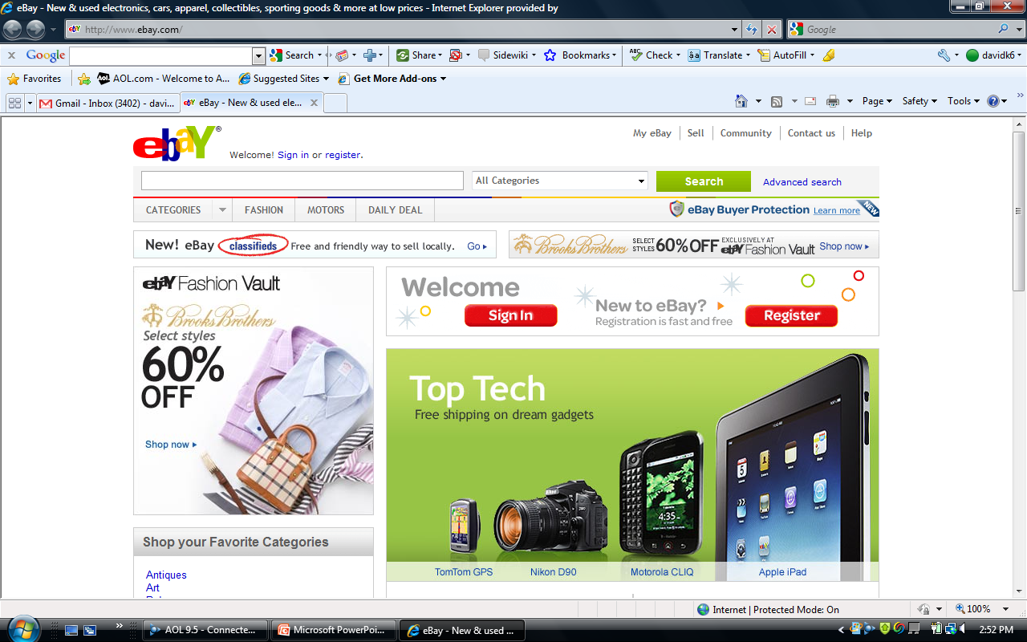

Slide 13
CS574 Object-Oriented Analysis & Design
Homework (cont.)
After you have clicked on “register” you will see the screen shown on the next slide.
Fill it out and register for your eBay account. (If you already have an eBay account skip this step and simply Sign in.)

Slide 14
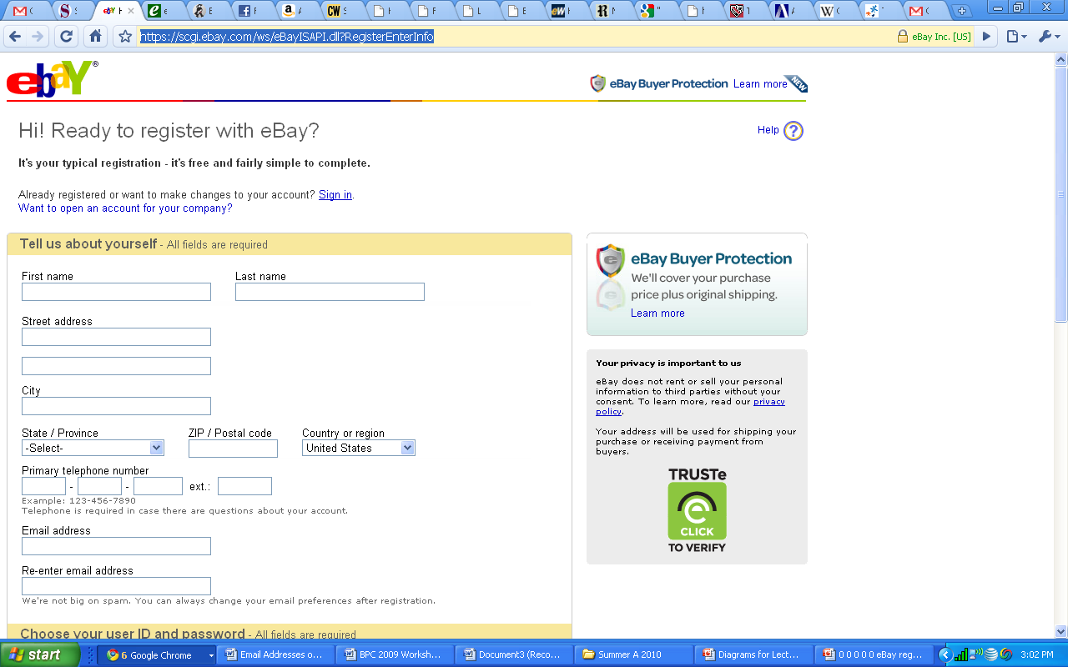

Slide 15
CS574 Object-Oriented Analysis & Design
Homework (cont.)
In either case you will now be on the “my eBay” screen.
Take a screen shot and paste it into an MS Word document or a ppt document to which additional information will be added before it is submitted as homework for this week.
At this point you are going to perform a search.
The example screen shot on the next slide shows
  A text box into which search terms, also known as keywords are typed. (We have typed in Hoboken history there.)
  A drop down list labelled categories, which we’ll discuss in a few slides
  The search button which you click on to perform a search.

Slide 16
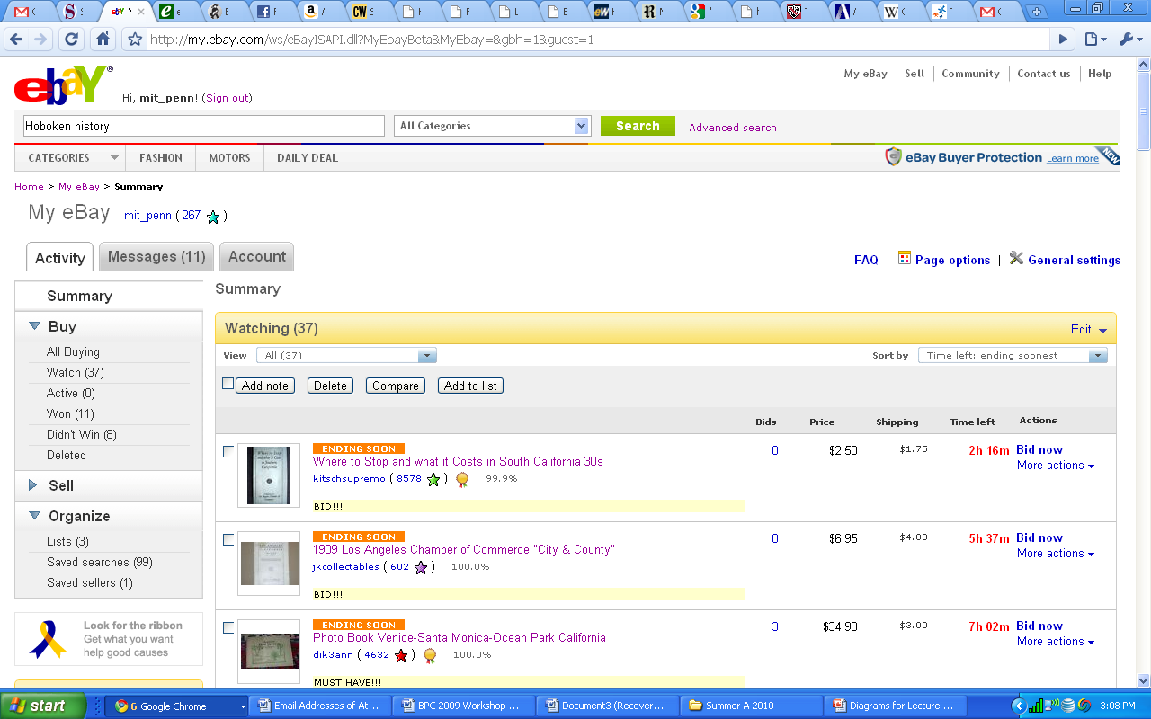

Slide 17
CS574 Object-Oriented Analysis & Design
Homework (cont.)
If we hit the search button, we get the screen, shown on the next slide, on which all matches to “Hoboken history” are shown, in this case four books.
At this point type in a list of keywords to search for items that might be of interest to you – you decide.
Hit the search button, take a screen shot of the resulting screen, and add it to the MS Word or ppt document that you will submit as your homework. (Be sure to label each screen shot with a description of which step in this process it represents.)
If you want to save a search pattern after you have performed the search on it, you can click on the save this search and alert me later link. (See the pointer on the next slide.)

Slide 18
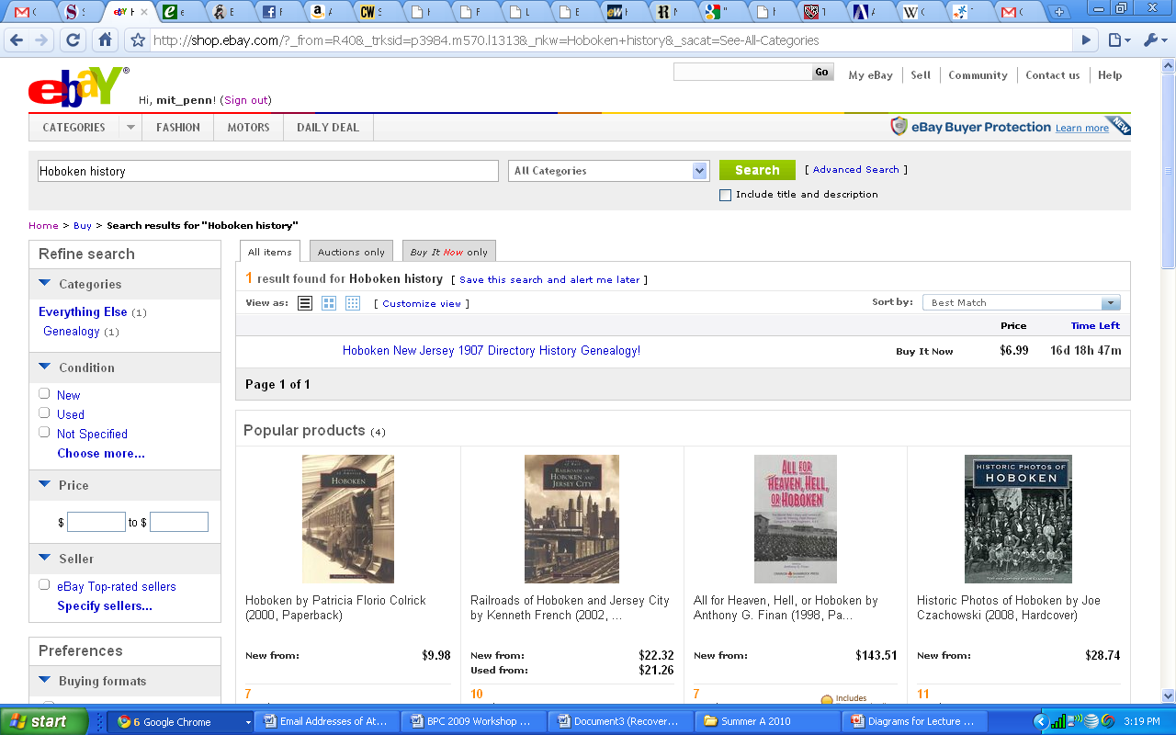

Slide 19
CS574 Object-Oriented Analysis & Design
Homework (cont.)
On the next slide you will see a screen shot of the screen that you’ll see after you click on the save link.
Choose the parameter values that you want and click on the Save button on the dialog box.
Take a screen shot after you have chosen the desired parameter values and add it to your homework document.

Slide 20
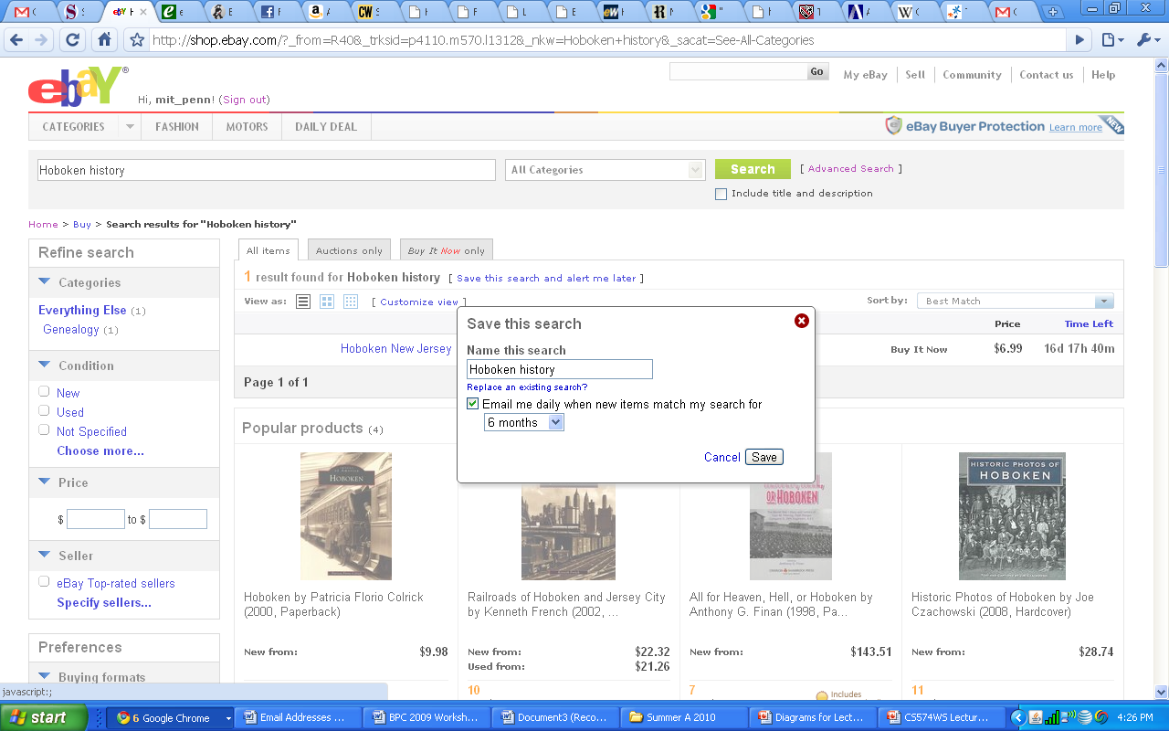

Slide 21
CS574 Object-Oriented Analysis & Design
Homework (cont.)
If you want to specify additional constraints/parameters for a search, click on the Advanced Search link shown on the next slide.
We did this after we entered “Hoboken history” into the text box and got the screen shot shown in the slide following the next slide.
At this point create an advanced search, for something other than your first saved search; be sure to use at least three or four of the possible advanced search parameters.
Take a screen shot before you execute the advanced search and put it into your homework document.
Then save this advanced search.

Slide 23
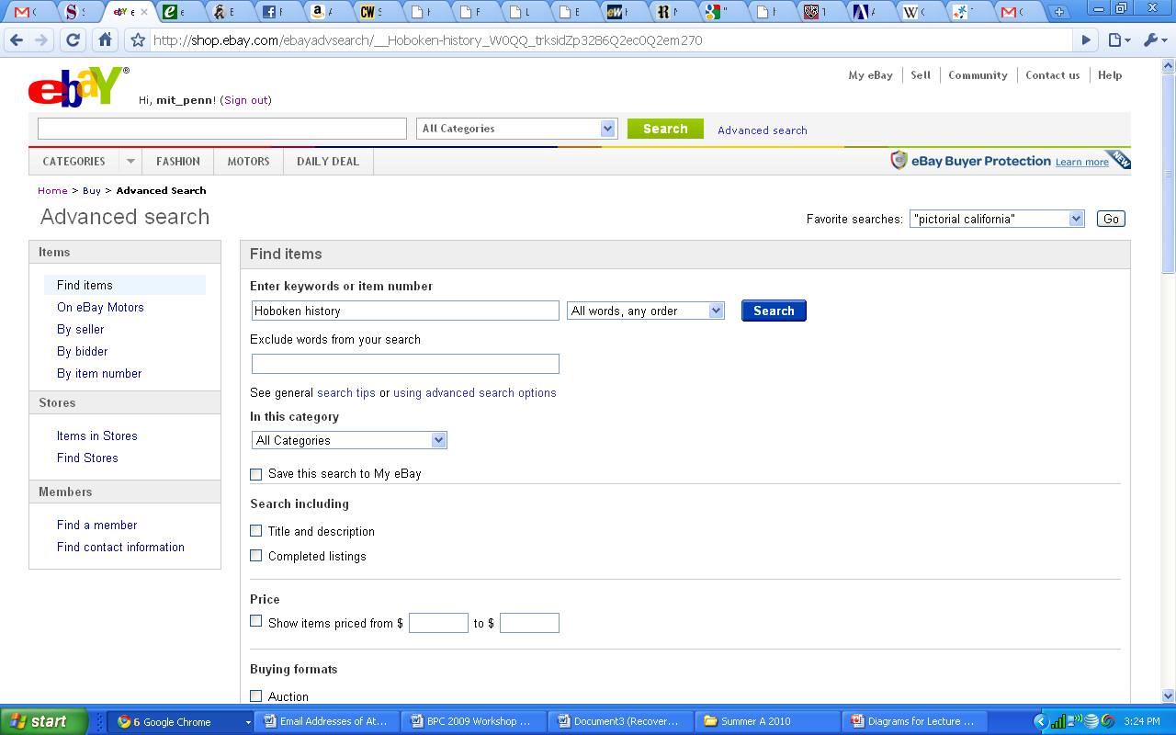

Slide 24
CS574 Object-Oriented Analysis & Design
Homework (cont.)
By the way, if you don’t want to search for matches in All Categories – see next slide -- you can pull down the pull-down list of categories, in which case you’ll get a screen that looks like the one on the slide after the next slide.

Slide 26
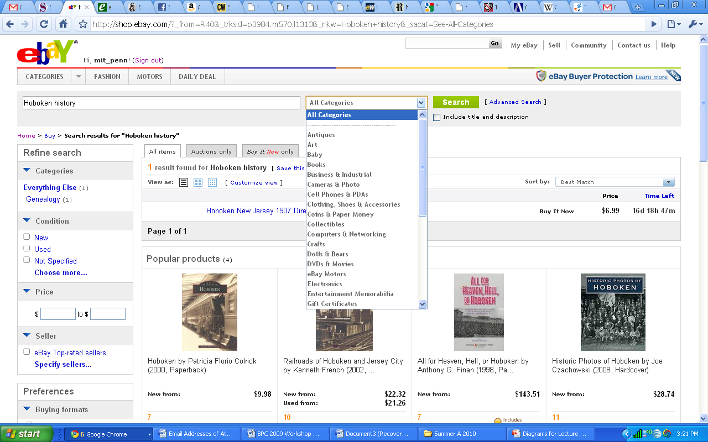

Slide 27
CS574 Object-Oriented Analysis & Design
Homework (cont.)
Wait until you get email matches for the two searches that you saved.
Be sure to do this homework at least a few days before it is due, because if you don’t you may not get email matches in time to submit the homework, in which case you won’t get credit for the homeworks
Finally, take a screen shot of each email and paste it into your homework document.

